Slide 1
2024
VDart Brand Profile Picture
How-to Guide For LinkedIn, Zoom, & other Internal Platforms

Slide 2
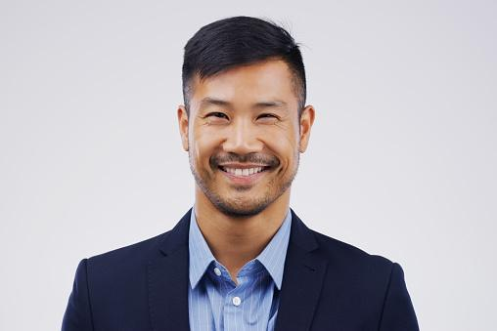
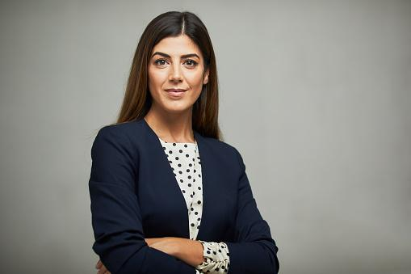




Professional Photo Tips
Photo should be formal
Photo should have a plain background
Photo should be cropped in passport size or half size
Photo should not be a selfie or any other casual poses
Photo should not be in out of focus
02

Slide 3


Our Logomark
This is our VDart Logomark
It can only be used by our VDart Employees
05

Slide 4

How To Create a
VDart Brand Profile Picture
Step-1
Select your "Professional Headshot Image" from your computer (Refer Slide No: 2)
The photo should have a "Plain Background" and have better quality
The format of the photo should be .jpg, .jpeg, .png
03

Slide 5
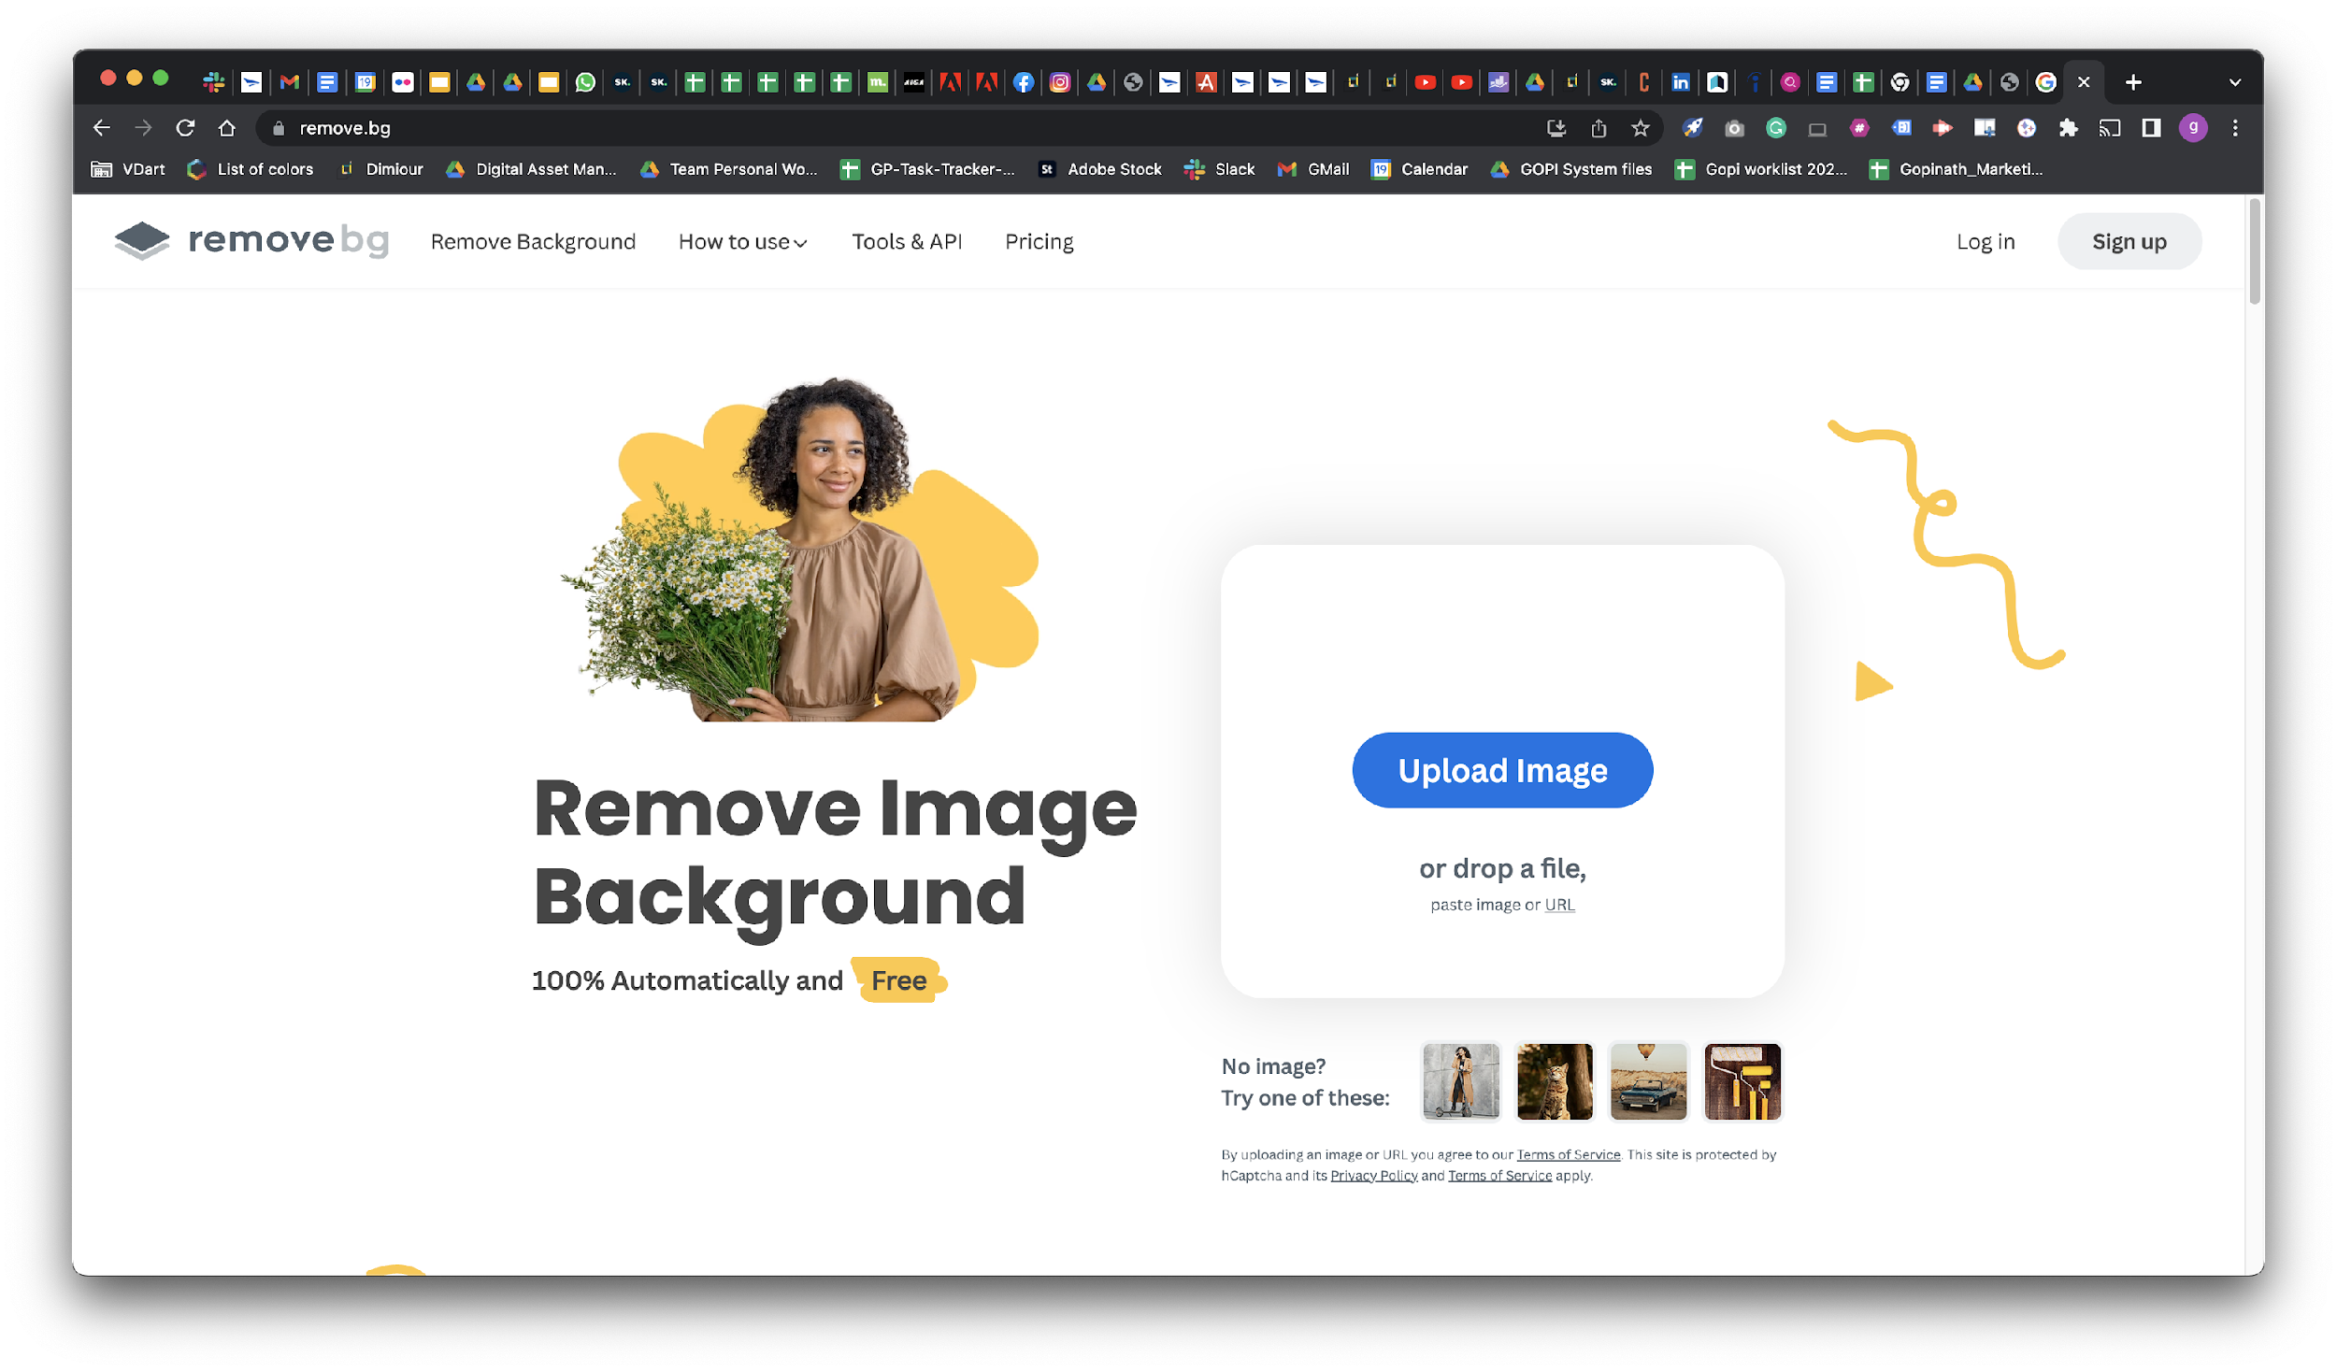
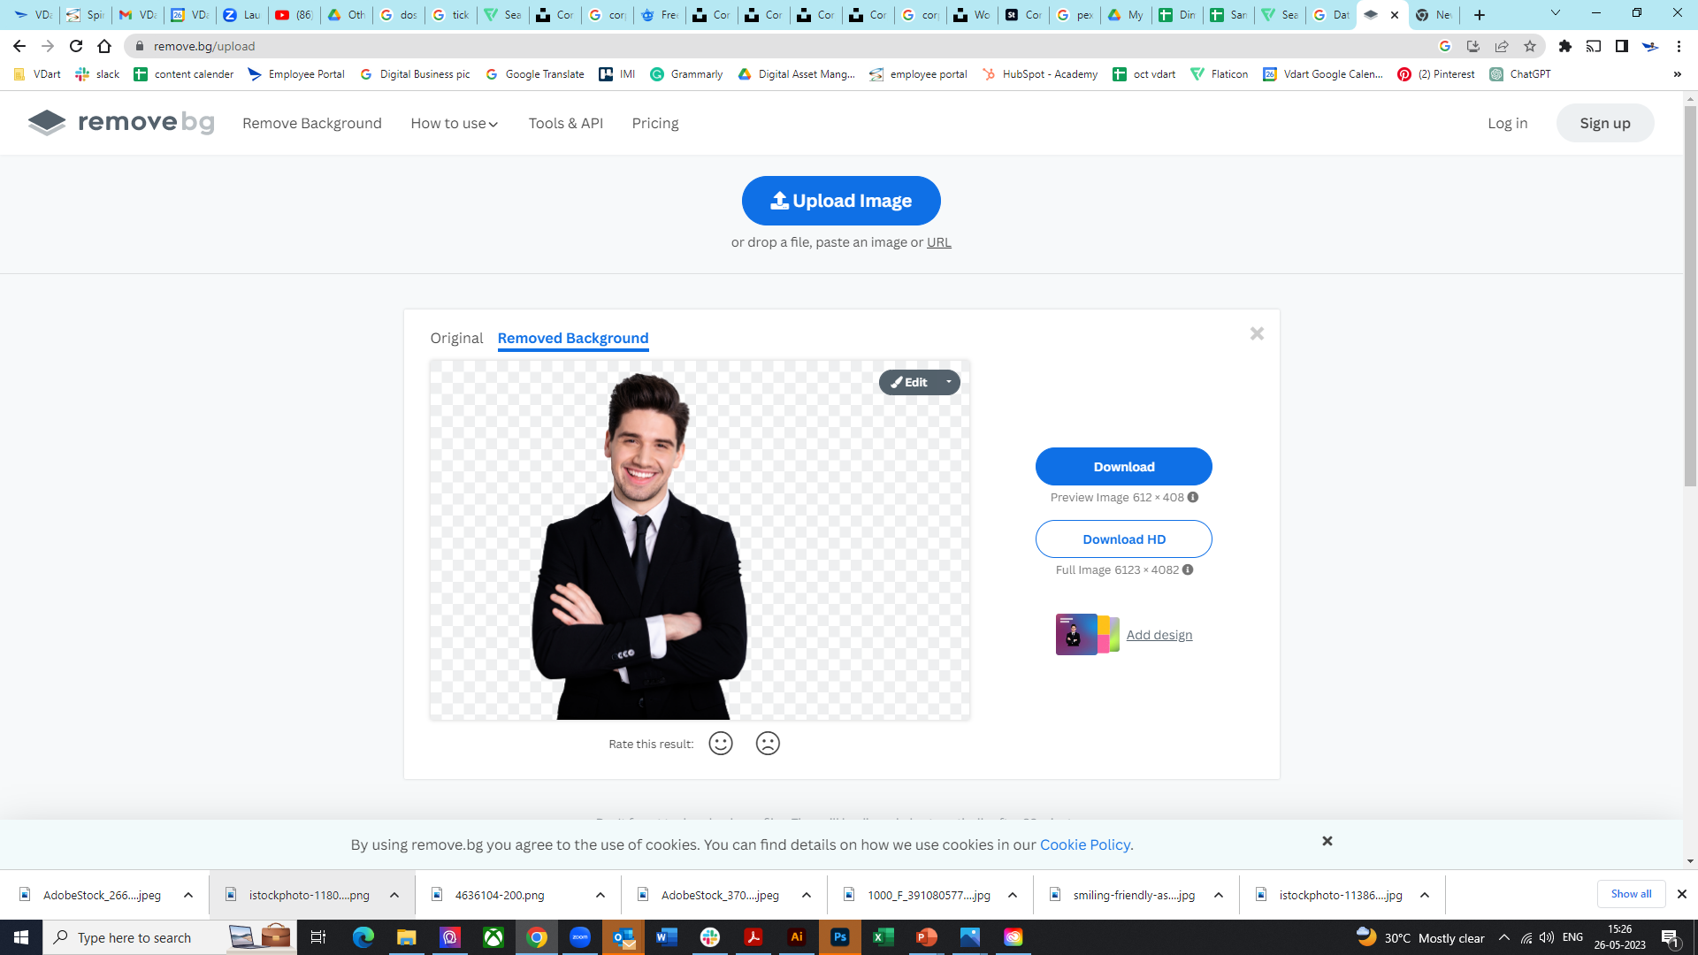
Remove Image Background
No.2
Step-2
Go to https://www.remove.bg/ by holding the "ctrl" button + clicking on the link
You will see an option called "Upload Image." Click the "Upload Image" button to upload your "Professional Headshot Image"
Once it is uploaded, click "Download"
No.3
04

Slide 6
Placing Your Downloaded Image
Step-3
To change the picture, right-click on the person in the red box, then choose Change Picture > This Device > Select your background-removed picture> Click Open. This will automatically replace the sample image with your image
Next, click on your picture. White Circles will appear on the four corners hold "Shift" and drag any of the corner circles, to place your image fit in the center of the red box
Next, select all three ‘clicks’ while holding shift the entire time.
Once all three ‘clicks’ are selected, right click, Group
Right click again and select copy
VDart Logomark 1 (click 1)
Professional
Headshot Image
(click 3)
VDart Logomark 2 (click 2)
06

Slide 7

Export and Save Your
VDart Brand Profile Picture
Step-6
"Right Click" and Paste the "Group/Image" using (Use Destination Theme (H)) on this slide.
"Right Click" on the “Group/Image” and select "Save as a Picture“.
Name your picture file and click "Save" to save your new VDart Brand Profile Picture
08

Slide 8
Reference
Profile Photo Sizes In Pixels
Facebook profile picture size: 170 x 170
Instagram profile picture size: 320 x 320
Twitter profile picture size: 400 x 400
LinkedIn company logo size: 400 x 400
Source: https://blog.hootsuite.com/social-media-image-sizes-guide/#Facebook_image_sizes

Slide 9



Headquarters:
VDart Inc
11180 State Bridge Road, Suite 302,
Alpharetta, GA 30022.
United States
Contact Us :
Toll Free : (800) 371 -1664
Phone Number : (678) 685-8650
Fax : (866) 431 -2320
Disclaimer:
© VDart Inc 2023.
All Rights Reserved.
Contact Us | Disclaimer | Privacy Policy

